Slide 1






Foundations of
Quantum Information Science (QIS 101)
Dave Biersach
Brookhaven National Laboratory
dbiersach@bnl.gov
Session 19
Dynamical Systems

Slide 2
Session 19 – Goals
Introduce Dynamical Systems
Discuss Stable Orbits by graphing the Logistics Map
Review Bifurcation and Feigenbaum's Constant
Visualize the Mandelbrot Set
Review 2D Affine Transformations
Rotation, Translation, Scaling, Reflection
Calculate Transformation Matrices
Understand Iterated Function Systems (IFS)
Draw shapes using a series of base frame mappings
Leverage the Collage Theorem to render images at any detail level

Slide 3
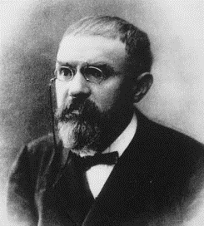
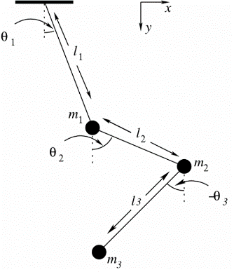
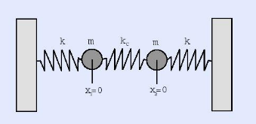
Dynamical Systems
Initially formalized by Henri Poincaré in 1905, a dynamical system is a set of equations describing how points in space move over time
Triple pendulums, connected springs, turbulence
Predator-Prey equations, stock market fluctuations
At any time, a dynamical system has a state vector that represents a point on a geometrical manifold called phase space
Small changes in the initial state vector can lead to wild swings in the long-term system output – the system may descend into chaos

Slide 4
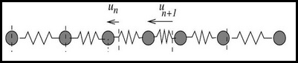
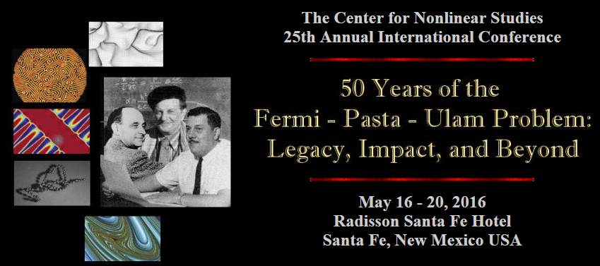
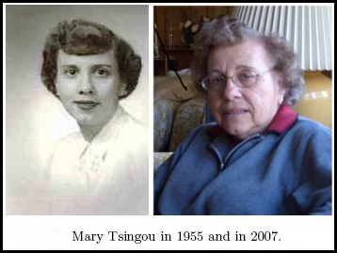
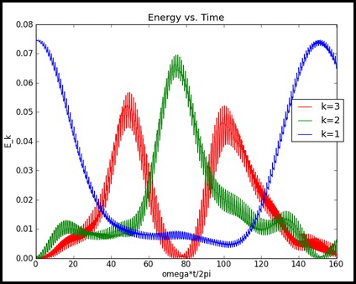
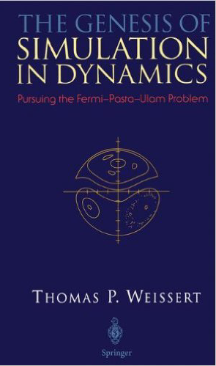
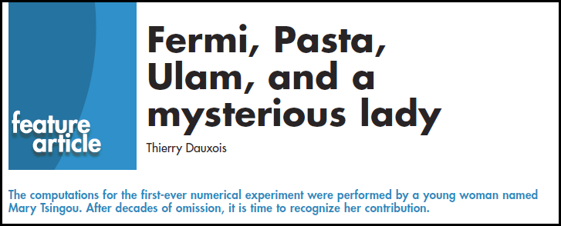
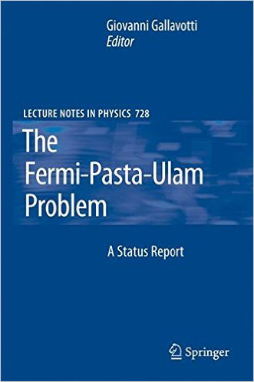
FPU – Birthplace of SciComp

Slide 5
Stable Orbits
A simple dynamical system can be generated by repeatedly invoking a single function
It is not that the function is recursive (it does not call itself), but that the function is put into what is known as a closed loop
The output of the prior iteration is passed as input parameters into the next iteration
We study the trajectory of the output values as we iterate from the given initial state vector
The function may be stable under iteration, meaning it closes onto into a finite repeating sequence of values (an orbit) – this is also know as the “strange attractor” of the system
Alternatively, the function may blow up and rapidly reach +/- ∞

Slide 6
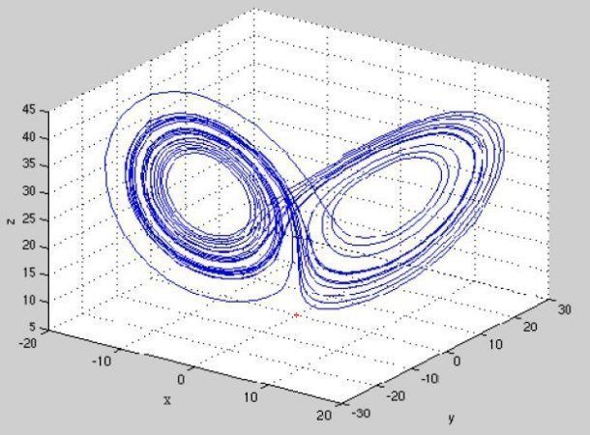
Stable Orbits
This phase space has a strange attractor
This plot is the phase space of a dynamical system

Slide 7
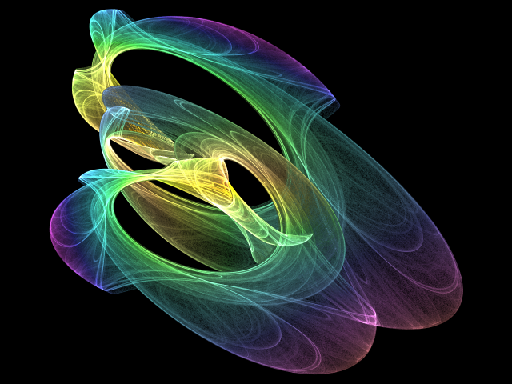
Stable Orbits

Slide 8
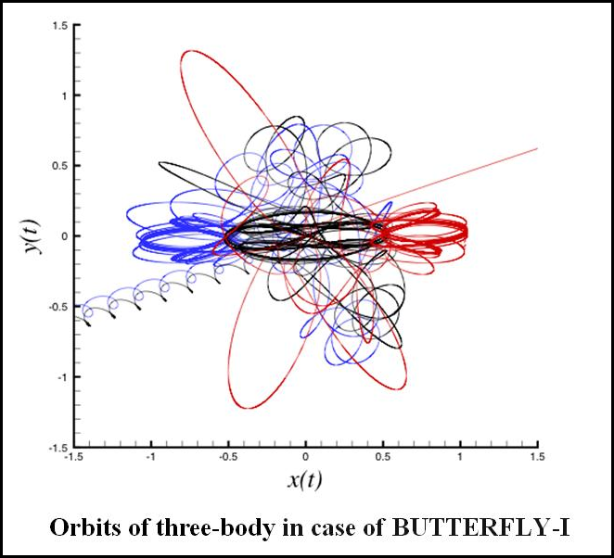
Unstable Orbits
After some chaotic “circling” the particles eventually fly off in opposite directions

Slide 9
The Logistic Map
For some dynamical systems, the eventuality of achieving convergence to orbital stability, or the rapid divergence to chaos (or infinity), can be unexpectedly affected by just a tiny change in the initial state vector
Consider the logistic map, a simple nonlinear equation:
$$y_{n+1}=x∙y_{n}∙\left(1−y_{n}\right)$$
We can iterate this function for any fixed $x$ and random $y_{0}$
It is amazing how even this simple formula behaves so wildly for slightly different values of $x$
Also surprising is that it matters little what we pick for $y_{0}$ – if the orbit is stable, it will eventually converge to the same repeating sequence for the given $x$

Slide 10
The Logistic Map
We pick a fixed value for x:
$$0 <x ≤4$$
$$y_{n+1}=x∙y_{n}∙\left(1−y_{n}\right)$$
The output of each iteration becomes the new input
We pick a random initial value for y:
$$0 <y <1$$
After a few iterations, the orbit is now stable with a single period

Slide 11
The Logistic Map
$$y_{n+1}=x∙y_{n}∙\left(1−y_{n}\right)$$
After a few iterations, the orbit is now stable with a period of 2
Same $y_{0}$but now with x = 3.4

Slide 12
The Logistic Map
$$y_{n+1}=x∙y_{n}∙\left(1−y_{n}\right)$$
After a few iterations, the orbit is again stable with a period of 2
Same x but with different $y_{0}$
It is the value of x (the initial state vector in this dynamical system) that determines the orbital period, not $y_{0}$

Slide 13
The Logistic Map
$$y_{n+1}=x∙y_{n}∙\left(1−y_{n}\right)$$
Now the orbit has a period of 4 This is called period doubling
Same $y_{0}$but now with x = 3.52

Slide 14
The Logistic Map
$$y_{n+1}=x∙y_{n}∙\left(1−y_{n}\right)$$
Now there is no stable orbit.
There is no repetition in the sequence of output values.
Same $y_{0}$but now with x = 4.0
This is called chaos

Slide 15
Drawing the Logistic Map
The goal is to draw the Logistic Map on screen to see the values of x where period doubling occurs
The function we wish to iterate is: $y_{n+1}=x∙y_{n}∙\left(1−y_{n}\right)$
We will slowly vary x from 2.5 up to 4.0 in steps of $∆x$
Then for each current x value:
We pick a random starting value for y where $0 <y <1$
We then iterate the logistic map equation 500 times to ensure it has a good chance to reach its stable orbit (if one exists)
Finally we iterate the equation another 500 times, but this time during each iteration of the equation, we plot on screen the point at the current value of x and y

Slide 16
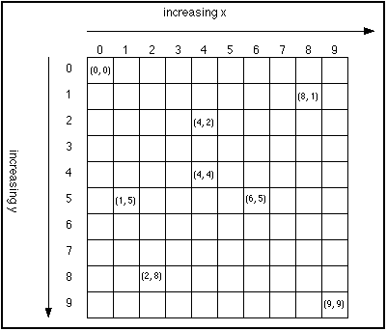
Screen Y vs. World Y Coordinates
In screen coordinates, as you move from the top of the screen towards the bottom, the Y coordinate increases!
This is the exact opposite of world (Cartesian) coordinates
Fortunately, the X axis behaves the as expected between the screen and world coordinate system
This discrepancy will drive you nuts!

Slide 17
World Bounding Rectangle
World coordinates are what we use when doing pure math
Screen coordinates are what we have to use when drawing
We need a way to map World X,Y to Screen X,Y
The world is framed by a “bounding rectangle” which is conveyed by specifying two points:
(world_xmin, world_ymin)
(world_xmax, world_ymax)
The values for all four World variables are our choice – they can be as big or as small as we want them

Slide 18
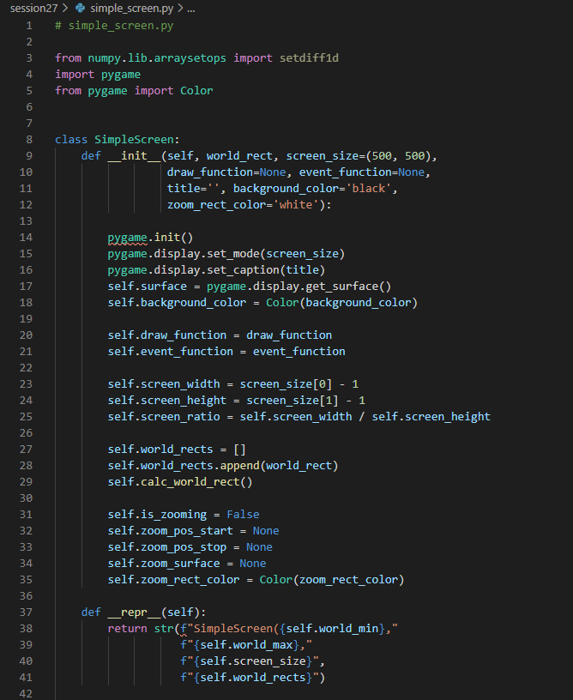
The SimpleScreen Class
Your App
SimpleScreen
pygame

Slide 19
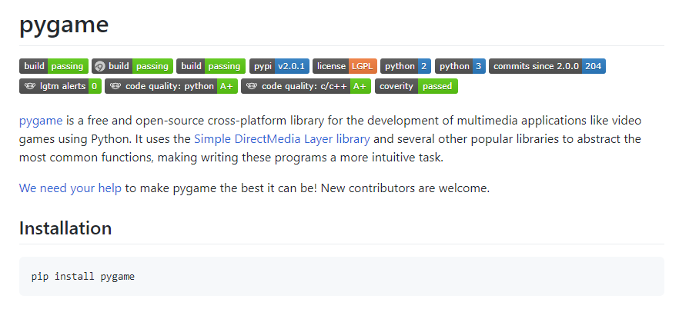
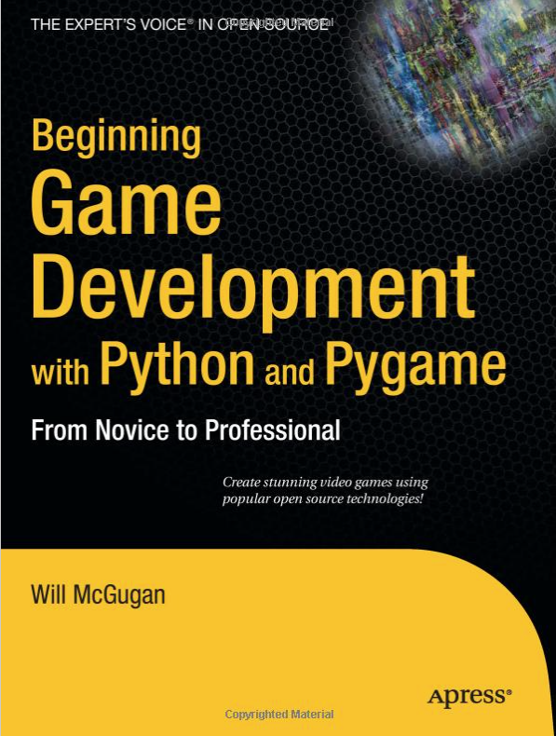
The pygame Package
https://github.com/pygame/pygame

Slide 20
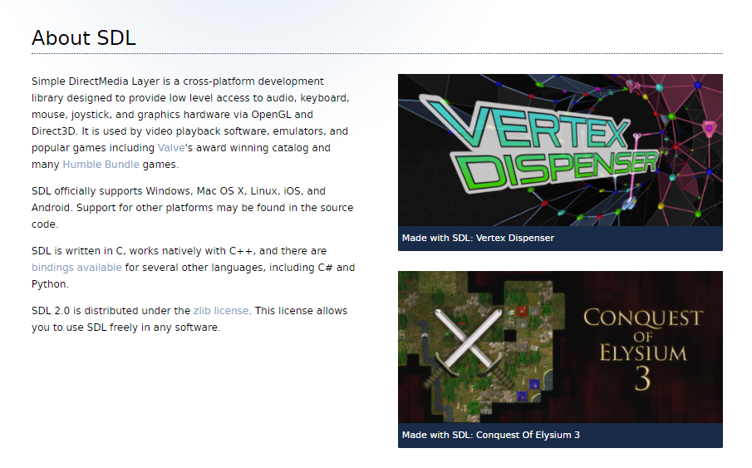
The pygame Package
https://www.libsdl.org

Slide 21
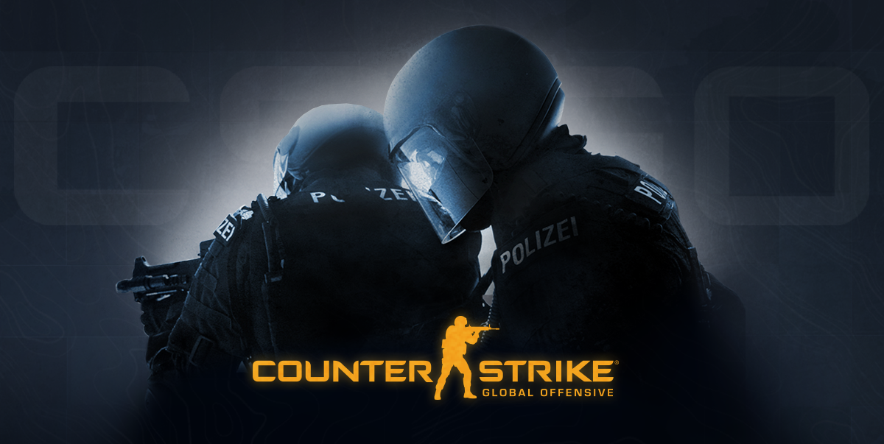
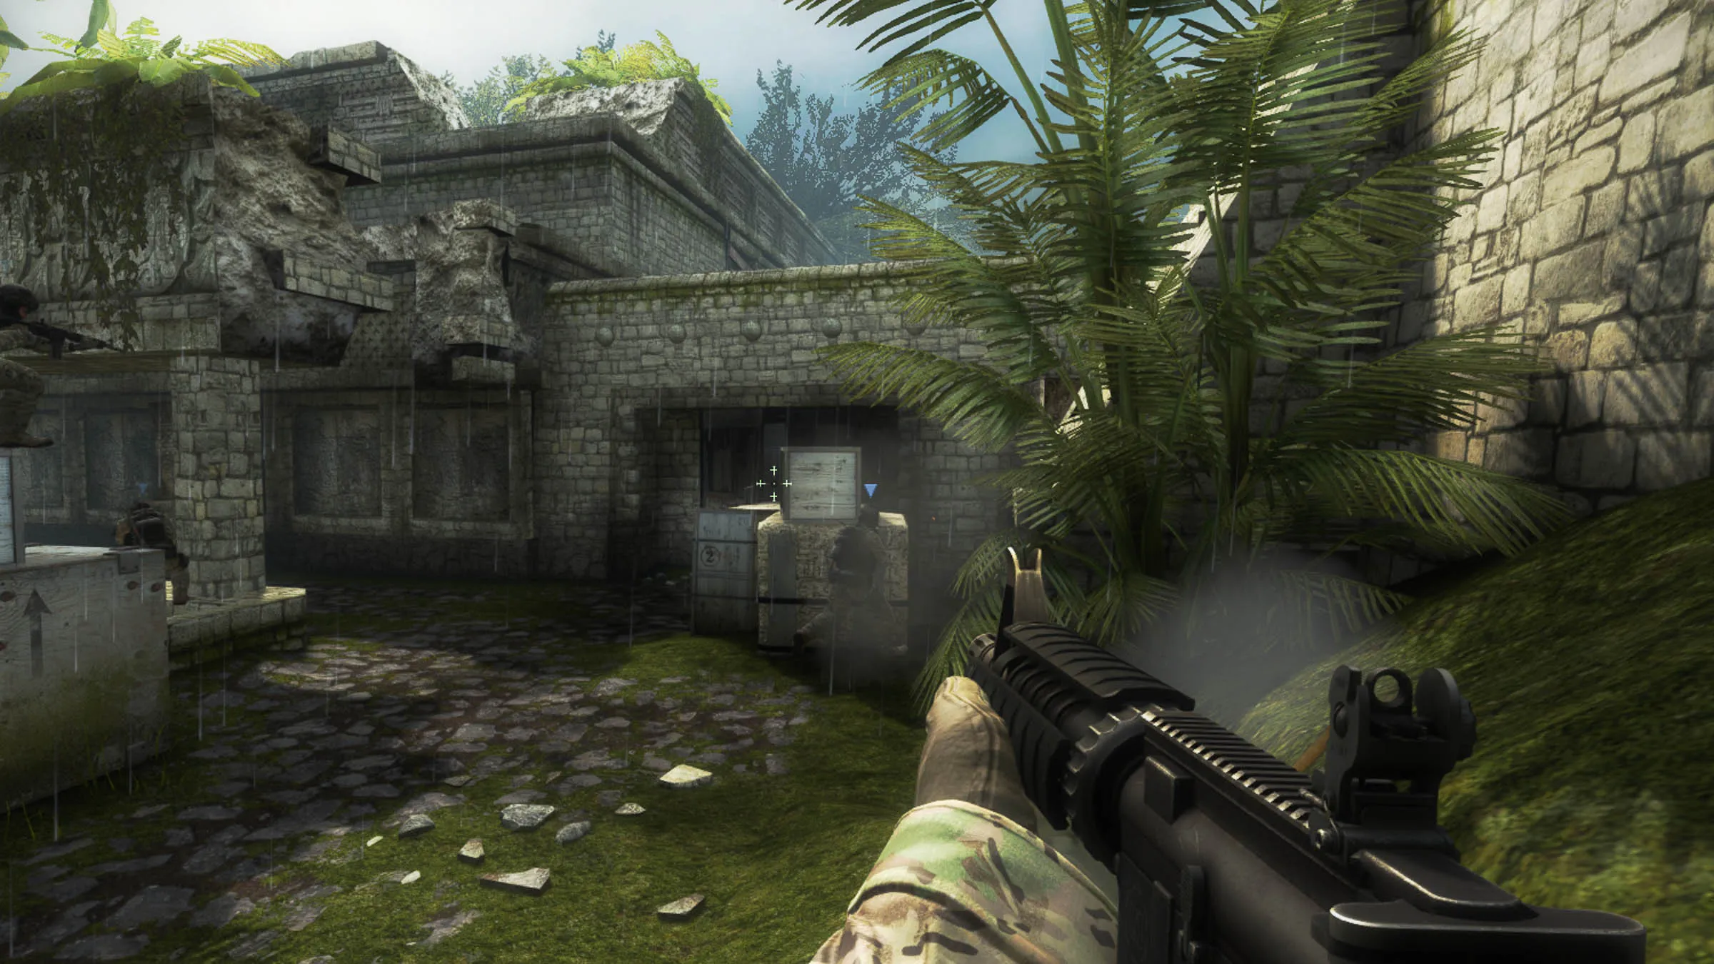

Slide 22

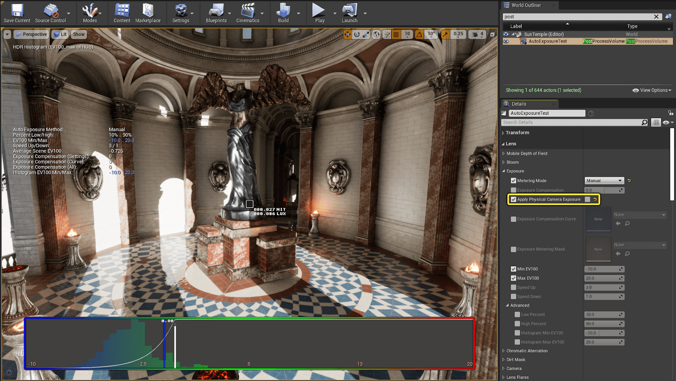

Slide 23
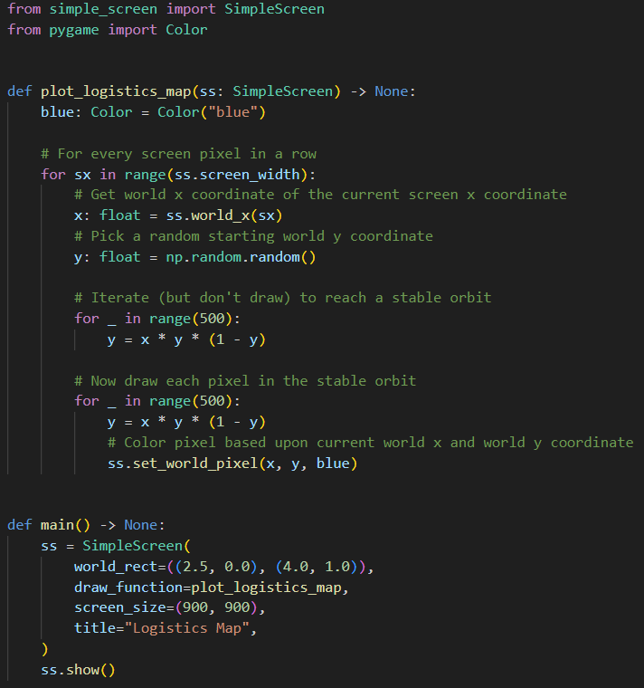
Open logistics_map.py
①
④
⑤
⑥
⑦
⑧
⑨
⑩
②
③

Slide 24
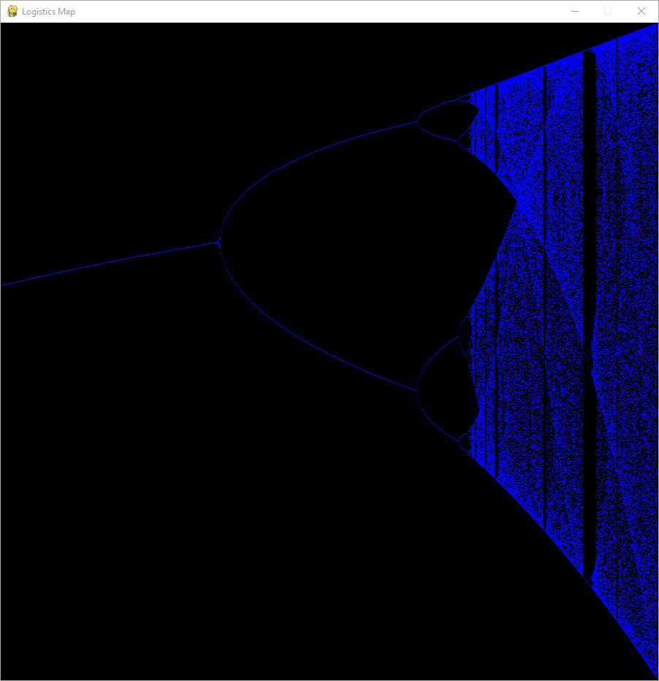
Run logistics_map.py
For each $x$ value, we first pick a random $y_{0}$
We then iterate the function 500 times without plotting its value
After the first 500 iterations, we then plot on screen the value of the next 500 iterations
Increasing y (0 ≤ y ≤ 1.0)
Increasing $x$ (2.5 ≤ $x$ ≤ 4.0)

Slide 25
Run logistics_map.py
Between 3 < $x$ < 3.449
y oscillates between two (changing) values as x increases
Between 3.449 < $x$ < 3.544
y oscillates between four (changing) values as x increases
As$x$ increases, the orbit continues to double in the number of stable points – this is called bifurcation

Slide 26
The Logistic Map
The logistic map shows unexpected major changes in its trajectory (or orbit) under iteration for small changes in $x$
$$y_{n+1}=x∙y_{n}∙\left(1−y_{n}\right)$$
What is it about those specific values of $x$ that causes the period to bifurcate?
Why does it not matter what $y_{0}$ value is first used?
Just as an infinite series might converge to a limit, an iterated dynamical system might “converge” to a strange attractor

Slide 27
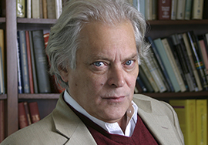
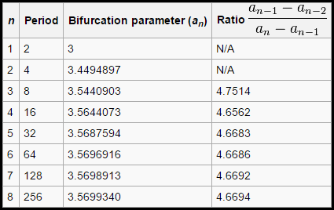
Feigenbaum Constant
In 1978, Mitchell Feigenbaum was a young student in New York City holding his very first calculator
He wondered if there was anything interesting in the ratio of the specific values for x which cause the logistic map to bifurcate (to double the period of the strange attractor)
All dynamical systems seem to share this lurking constant!
It is the $π$ of the
21st century!

Slide 28
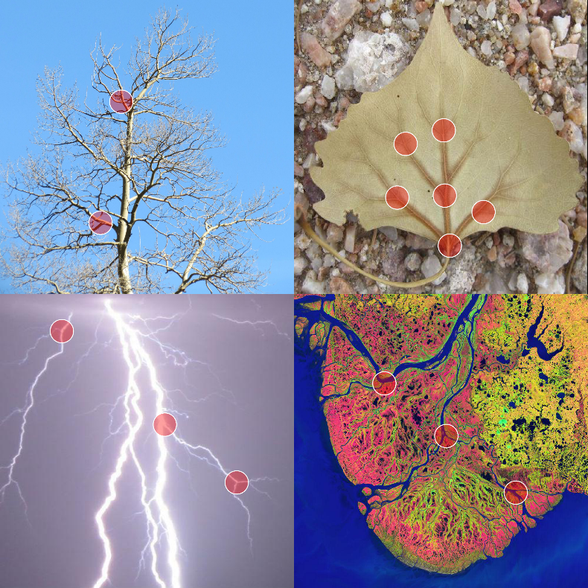
Feigenbaum Constant

Slide 29
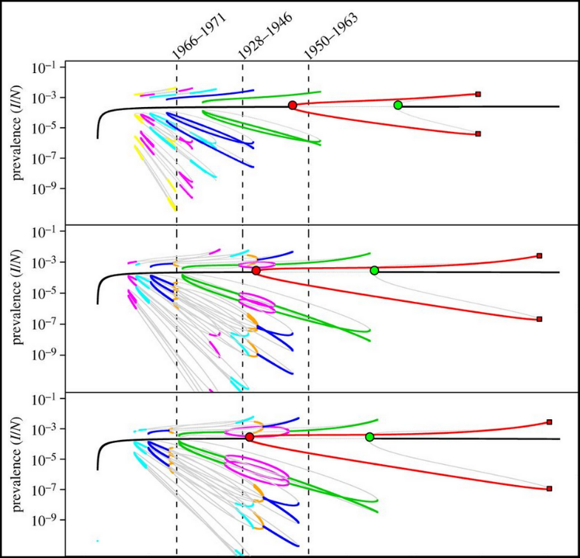
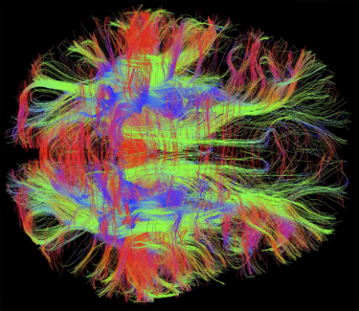
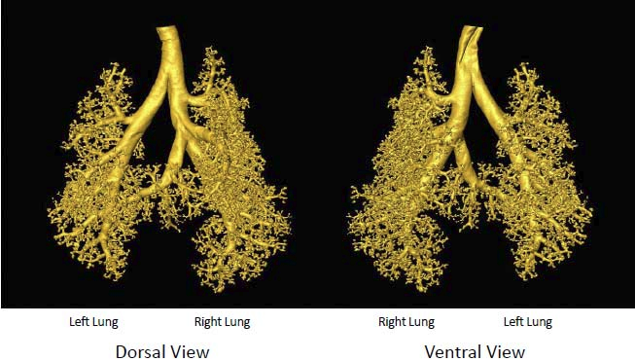
Feigenbaum Constant

Slide 30
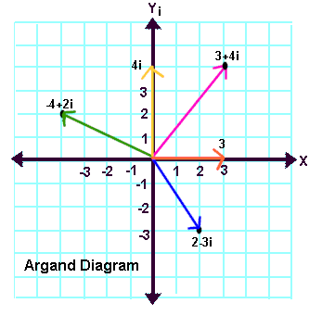
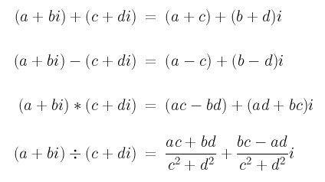
Complex Number Algebra
$$magnitude= \sqrt{a^{2}+b^{2}}$$

Slide 31
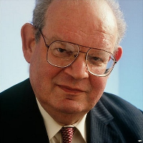
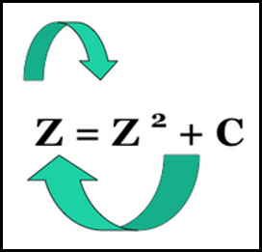
The Mandelbrot Set
In 1980 Benoit Mandelbrot considered the logistic map but expanded the domain to include the complex numbers
Mandelbrot asked what happens if we square a complex number (a + bi) every iteration
How many iterations will it take before its magnitude > 2.0?
Are there points where the iterated magnitude never exceeds 2.0?
Mandelbrot wondered what unknown bifurcations and strange attractors might be hiding in the set of complex numbers while under iteration?

Slide 32
The Mandelbrot Set
Mandelbrot’s algorithm
Take every point in the complex plane and keep squaring it
Count the number of iterations before the magnitude exceeds 2.0
If magnitude remains $≤$ 2.0 then color that (x, y) coordinate black
If $>$ 2.0, then color that (x, y) point according to a fixed color palette that indicates the number of iterations it took to "escape"
The escape time represents the number of iterations for the complex magnitude to grow beyond 2.0

Slide 33
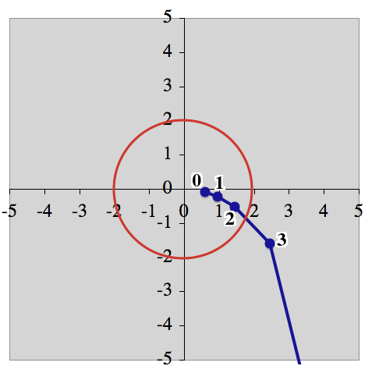
The Escape Time

Slide 34
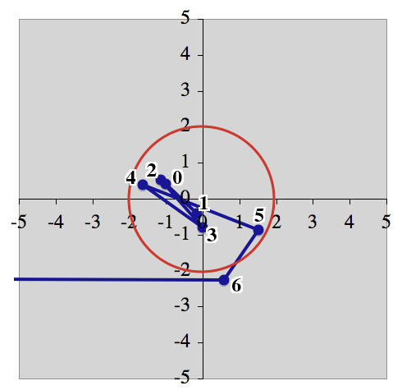
The Escape Time

Slide 35
The Mandelbrot Set
The 2D Cartesian $\left(x,y\right)$ world coordinate being iterated
$$Z_{c}=\left(x_{c}+iy_{c}\right)$$
Mandelbrot's Iteration Formula
$$Z_{n+1}={\left(Z_{n}\right)}^{2}+Z_{c}$$
Write real and imaginary terms
$$Z_{n+1}={(x_{n}+iy_{n})}^{2}+\left(x_{c}+iy_{c}\right)$$
Expand square term
$$Z_{n+1}=\left(x_{n}+iy_{n}\right)\left(x_{n}+iy_{n}\right)+\left(x_{c}+iy_{c}\right)$$
Double distribute
$$Z_{n+1}=\left[{\left(x_{n}\right)}^{2}+2ix_{n}y_{n}−{\left(y_{n}\right)}^{2}\right]+\left(x_{c}+iy_{c}\right)$$
Regroup terms
$$Z_{n+1}=\left[{\left(x_{n}\right)}^{2}−{\left(y_{n}\right)}^{2}+x_{c}\right]+\left(2x_{n}y_{n}+y_{c}\right)i$$
Next real
Next imaginary

Slide 36
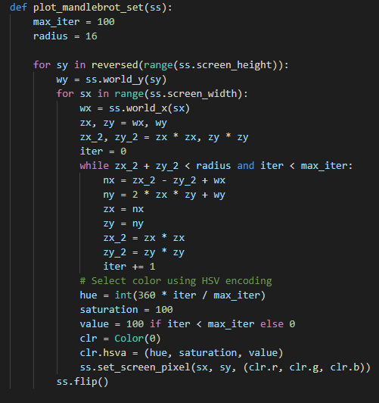
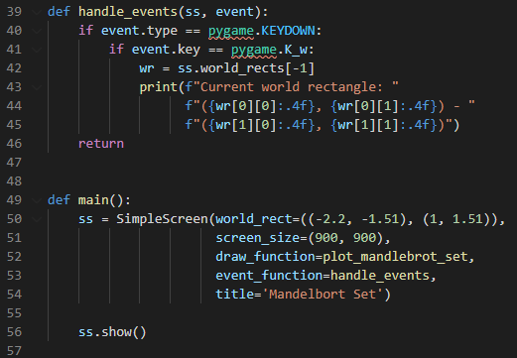
Open mandlebrot_set.py
③
④
⑤
⑥
②
⑦
⑧
⑨
①

Slide 37
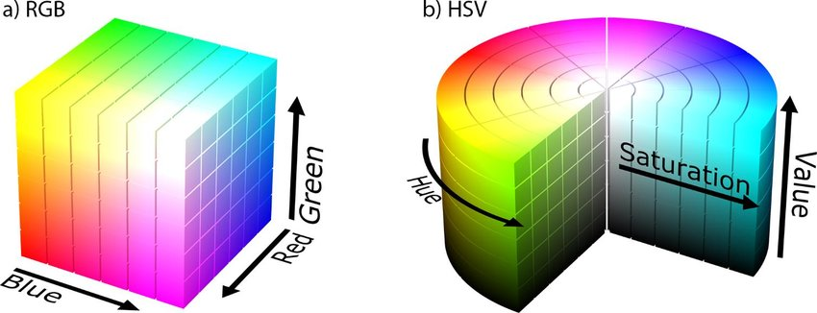
Color Spaces – RGB vs HSV
$$0≤R≤255$$
$$0≤G≤255$$
$$0≤B≤255$$
HSV cleanly separates
luma (image intensity)
from
chroma (color information)
$$0≤H≤360$$
$$0≤S≤100$$
$$0≤V≤100$$

Slide 38
Color Spaces – RGB vs HSV
$$0≤R≤255$$
$$0≤G≤255$$
$$0≤B≤255$$
HSV cleanly separates
luma (image intensity)
from
chroma (color information)
$$0≤H≤360$$
$$0≤S≤100$$
$$0≤V≤100$$

Slide 39
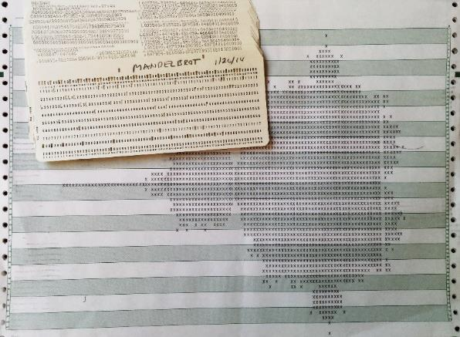
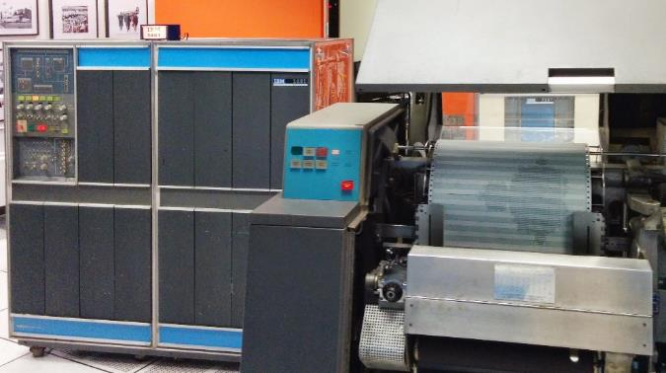
The Mandelbrot Set
When Mandelbrot first rendered his dynamical system, the generated image amazed everyone…
The set of complex numbers (squared) contains an internally consistent self-similarity at infinite levels of zoom!

Slide 40
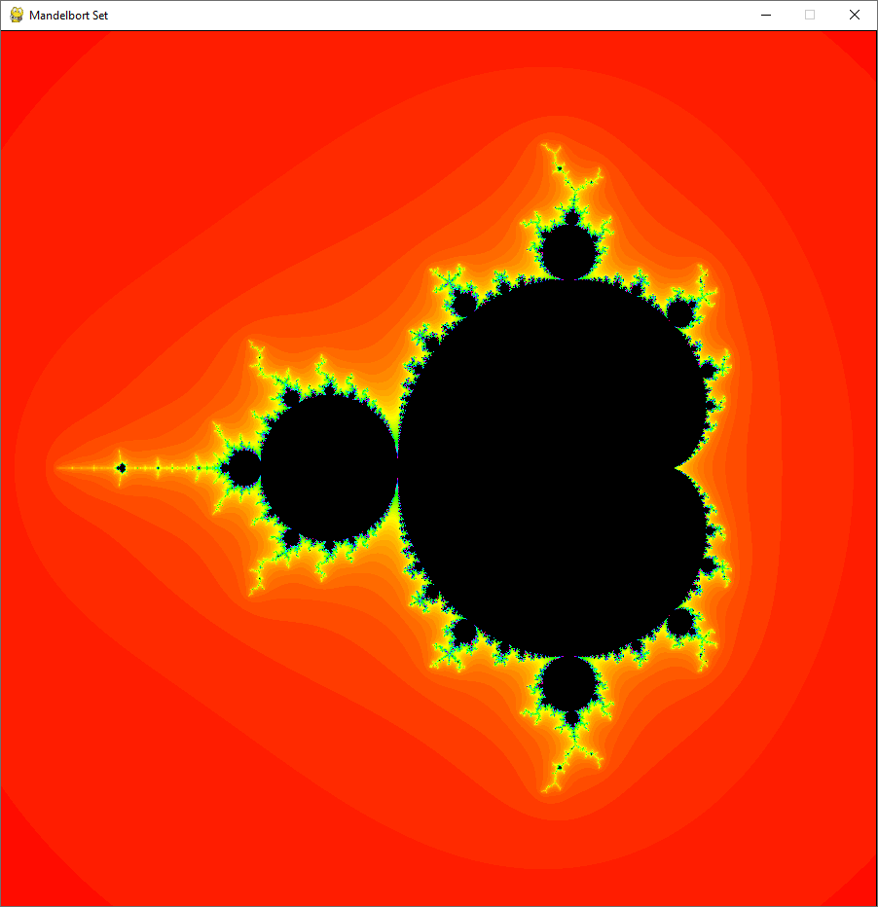
Run mandelbrot_set.py
$$(1.0+1.51i)$$
$$(−2.2−1.51i)$$

Slide 41

Run mandelbrot_set.py
Left click and drag to draw a Zoom window

Slide 42
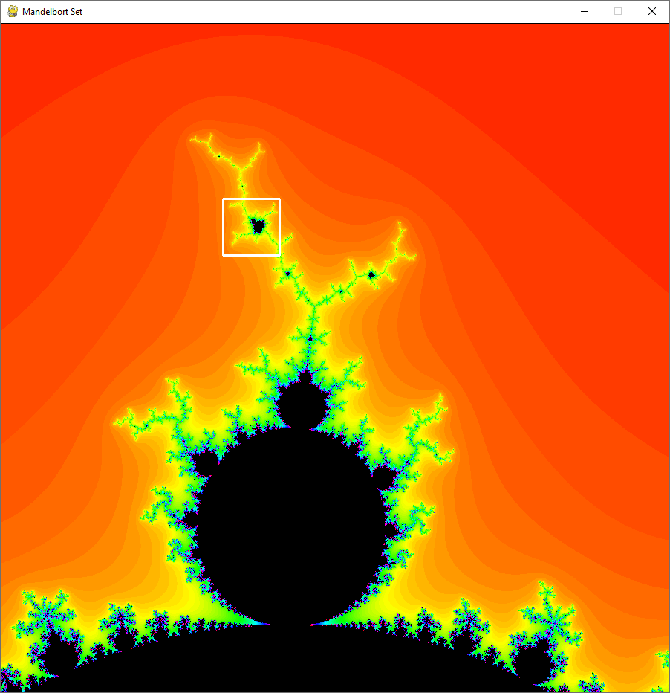
Run mandelbrot_set.py
Left click and drag to draw a Zoom window

Slide 43
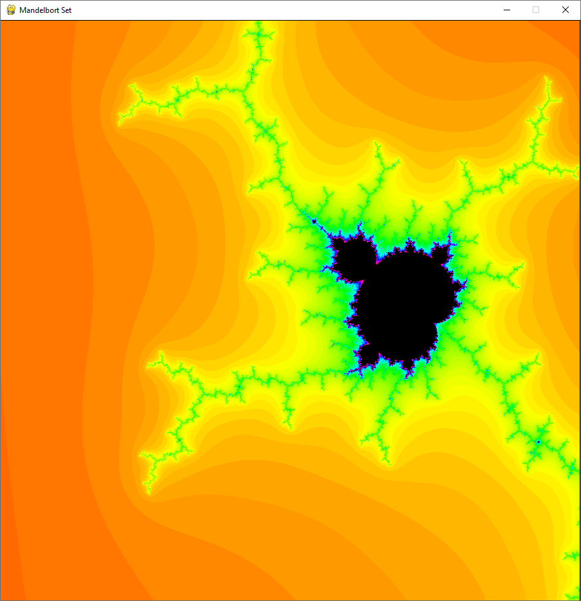
Run mandelbrot_set.py
Right click to return to prior Zoom state
Way down here is yet another copy of the set!

Slide 44
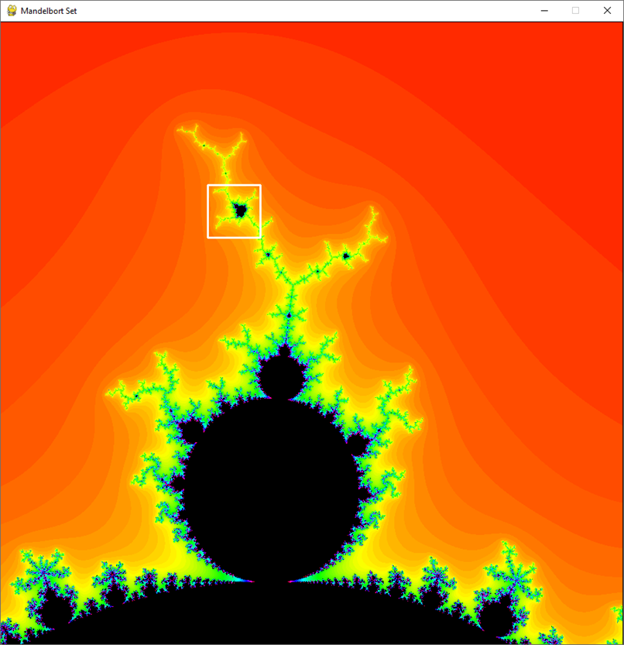
Run mandelbrot_set.py
As we zoom in (by shrinking the world rectangle) we see the Mandelbrot set completely repeating itself on infinitely smaller and smaller levels

Slide 45
Run mandelbrot_set.py

Slide 46
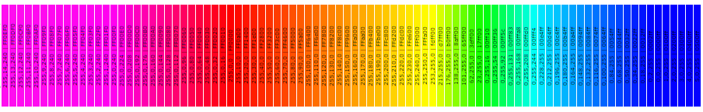
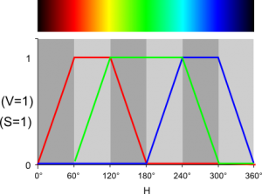
Temperature Color

Slide 47
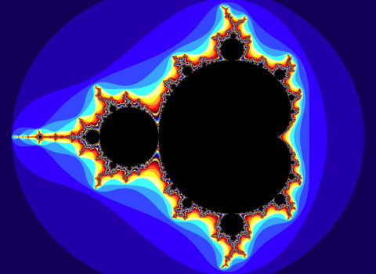
Mandelbrot Set

Slide 48
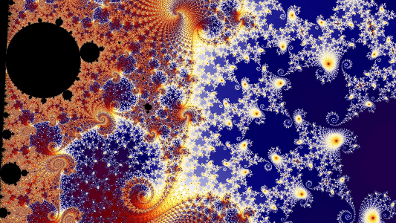

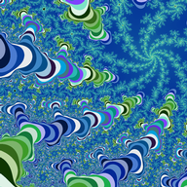

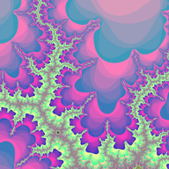

Slide 49


Slide 50



Slide 51


Slide 52


Slide 53

2D Affine Transformations
There are six possible transformations of an image
Scale (zoom, magnify, shrink)
Translate (move, slide, drag, push)
Rotate (turn, spin, twist)
Reflect (flip, invert, mirror)
Shear (stretch, squish, distort)
Identity (copy, no change, leave alone, skip)
Transformations # 1 - 3 are common touch screen operations

Slide 54







Rotation = Matrix Multiplication

Slide 55
2D Affine Transformations
We use matrices to apply transformations to an image
Represent each point to draw as a (1 x 3) matrix:$\left(\begin{matrix}x & y & 1\end{matrix}\right)$
Multiply this point matrix by a (3 x 3) transformation matrix
The result of (1 x 3) $•$ (3 x 3) = (1 x 3) which is the new point!
$$\left(\begin{matrix}x & y & 1\end{matrix}\right)•\left(\begin{matrix}a & d & 0 \\ b & e & 0 \\ c & f & 1\end{matrix}\right)=\left(\begin{matrix}x^{′} & y^{′} & 1\end{matrix}\right)$$
Each transformation type has its own distinct 3 x 3 matrix
Successive transformations applied to the same point are formed by a sequence of matrix multiplications

Slide 56


2D Affine Transformations
$$\left(\begin{matrix}W & 0 & 0 \\ 0 & H & 0 \\ 0 & 0 & 1\end{matrix}\right)$$
Scale
$$\left(\begin{matrix}1 & 0 & 0 \\ 0 & 1 & 0 \\ Δx & Δy & 1\end{matrix}\right)$$
Translate

Slide 57

2D Affine Transformations
$$\left(\begin{matrix}\cos{θ} & \sin{θ} & 0 \\ −\sin{θ} & \cos{θ} & 0 \\ 0 & 0 & 1\end{matrix}\right)$$
Rotate

Slide 58



2D Affine Transformations
$$\left(\begin{matrix}1 & 0 & 0 \\ 0 & −1 & 0 \\ 0 & 0 & 1\end{matrix}\right)$$
Reflect X
$$\left(\begin{matrix}−1 & 0 & 0 \\ 0 & 1 & 0 \\ 0 & 0 & 1\end{matrix}\right)$$
Reflect Y
$$\left(\begin{matrix}−1 & 0 & 0 \\ 0 & −1 & 0 \\ 0 & 0 & 1\end{matrix}\right)$$
Reflect XY

Slide 59



2D Affine Transformations
$$\left(\begin{matrix}1 & 0 & 0 \\ A & 1 & 0 \\ 0 & 0 & 1\end{matrix}\right)$$
Shear X
$$\left(\begin{matrix}1 & B & 0 \\ 0 & 1 & 0 \\ 0 & 0 & 1\end{matrix}\right)$$
Shear Y
$$\left(\begin{matrix}1 & 0 & 0 \\ 0 & 1 & 0 \\ 0 & 0 & 1\end{matrix}\right)$$
Identity

Slide 60

2D Affine Transformations
If we know the initial $(x, y)$and final $(x^{′}, y^{′})$ coordinates of a point after a transformation is applied, can we work backwards to determine the elements of the transformation matrix that caused that movement?
We have seen that a transformation matrix is 3 x 3, but it only has six unknowns because the last column is always set to (0, 0, 1) by definition
Therefore, to determine all six unknowns of the transformation matrix, we need to know the before & after coordinates of three separate points
Three points @ 2 coordinates each (x, y) $→$ six knowns
Six equations and six unknowns… we can solve that!

Slide 61
2D Affine Transformations
This is the unknown matrix
$$(x_{n}, y_{n})$$
are the known initial points
$$(x_{n}^{′}, y_{n}^{′})$$
are the known final points
$$\left(\begin{matrix}x_{1} & y_{1} & 1 \\ x_{2} & y_{2} & 1 \\ x_{3} & y_{3} & 1\end{matrix}\right)\left(\begin{matrix}a & d & 0 \\ b & e & 0 \\ c & f & 1\end{matrix}\right)=\left(\begin{matrix}x_{1}^{′} & y_{1}^{′} & 1 \\ x_{2}^{′} & y_{2}^{′} & 1 \\ x_{3}^{′} & y_{3}^{′} & 1\end{matrix}\right)$$
$$ax_{1}+by_{1}+c=x_{1}^{′}$$
$$dx_{1}+ey_{1}+f=y_{1}^{′}$$
$$ax_{2}+by_{2}+c=x_{2}^{′}$$
$$dx_{2}+ey_{2}+f=y_{2}^{′}$$
$$ax_{3}+by_{3}+c=x_{3}^{′}$$
$$dx_{3}+ey_{3}+f=y_{3}^{′}$$
Two systems of 3 unknowns can be solved to get a … f

Slide 62
2D Affine Transformations
$$\left(\begin{matrix}x_{1} & y_{1} & 1 \\ x_{2} & y_{2} & 1 \\ x_{3} & y_{3} & 1\end{matrix}\right)\left(\begin{matrix}a & d & 0 \\ b & e & 0 \\ c & f & 1\end{matrix}\right)=\left(\begin{matrix}x_{1}^{′} & y_{1}^{′} & 1 \\ x_{2}^{′} & y_{2}^{′} & 1 \\ x_{3}^{′} & y_{3}^{′} & 1\end{matrix}\right)$$
It is because we need three distinct points to calculate a transformation matrix that not all possible transformations can be indicated with just two fingers on a touch screen
Two points only solves four unknowns – so we can’t represent reflections (flips, reverses, mirrors) with only two fingers – only moving, rotating, and zooming transformations

Slide 63
Iterated Function System
An IFS is a set of 2D affine transforms (matrices)
During each iteration, the current $\left(x,y\right)$ pixel is colored
One of the transforms in the IFS is randomly selected based upon its probability value
The selected transform maps the current $\left(x,y\right)$ to $\left(x^{′},y^{′}\right)$
The $\left(x^{′},y^{′}\right)$ point becomes the new $\left(x,y\right)$ and the process repeats
Each IFS transform has a probability
In some systems, every transform has equal probability of being chosen for the current iteration
In other systems, the probability is not uniform, and some transforms may be favored over others

Slide 64
A Single Transformation Mapping
Point # 3
Top Left
Dave
Dave
Point # 1
Bottom Left
The
Base Frame
Point # 2
Bottom Right
Every mapping requires 3 points!

Slide 65

Multiple Transformation Mappings
(30, 30)
(0, 0)
The
Base Frame

Slide 66
Multiple Transformation Mappings
(0, 30)
(30, 30)
❸
(0, 15)
1
❶
❷
(0, 0)
(15, 0)
(30, 0)
Mapping #1
ifs.add_mapping(0, 0, 15, 0, 0, 15, "blue", p);
$${x′}_{1},{ y′}_{1}, { x′}_{2},{ y′}_{2}, { x′}_{3},{ y′}_{3}$$

Slide 67
Multiple Transformation Mappings
❸
1
2
❶
❷
(15, 0)
(30, 0)
Mapping #2
ifs.add_mapping(15, 0, 30, 0, 15, 15, "blue", p);
$${x′}_{1},{ y′}_{1}, { x′}_{2},{ y′}_{2}, { x′}_{3},{ y′}_{3}$$

Slide 68
Multiple Transformation Mappings
(30, 30)
(30, 30)
❸
3
1
2
❶
❷
(0, 0)
(0, 0)
Mapping #3
ifs.add_mapping(7.5, 15, 22.5, 15, 7.5, 30, "blue", p);
$${x′}_{1},{ y′}_{1}, { x′}_{2},{ y′}_{2}, { x′}_{3},{ y′}_{3}$$

Slide 69

Strange Attractor of Iterated Mappings

Slide 70
Strange Attractor of Iterated Mappings

Slide 71
Strange Attractor of Iterated Mappings

Slide 72
Strange Attractor of Iterated Mappings

Slide 73

Run ifs_triangle.py

Slide 74

Run ifs_triangle.py
Left click and drag to draw a Zoom window

Slide 75

Run ifs_triangle.py
Each triangle is made from many infinitely smaller triangles that are exact copies of the original image
Right click to return to prior Zoom state

Slide 76

View ifs_triangle.py
①
⑦
⑧
⑨
②
③
④
⑤
⑥

Slide 77

Edit ifs_triangle.py

Slide 78

Infinite Self-Similarity Creates Fractal Dimensions
A line is a 1D object
As the line folds and twists, it begins to occupy a 2D plane
If it continues to replicate itself at infinitely smaller detail, the 1D line will start becoming a 2D object
The line now has a fractional dimension, greater than 1, but not quite 2

Slide 79

Iterated Function System

Slide 80

Iterated Function System
xMax, yMax
(0, 48)
(48, 48)
The
Base Frame
(0, 0)
(48, 0)
xMin, yMin

Slide 81
Iterated Function System
Mapping #1
“Stem”
p = .01

Slide 82
Iterated Function System
Mapping #2
“Left Leaf”
p = .07

Slide 83
Iterated Function System
Mapping #3
“Right Leaf”
p = .07

Slide 84
Iterated Function System
Mapping #4
“Next Frame”
p = .85

Slide 85
Iterated Function System
Mapping #1
“Stem”
p = .01
Mapping #3
“Right Leaf”
p = .07
$$\left(\begin{matrix}0 & 0 & 0 \\ 0 & .2083 & 0 \\ 24.0 & 0 & 1\end{matrix}\right)$$
$$\left(\begin{matrix}.1562 & −.3125 & 0 \\ .3028 & .1778 & 0 \\ 20.5 & 14.0 & 1\end{matrix}\right)$$
Mapping #2
“Left Leaf”
p = .07
Mapping #4
“Next Frame”
p = .85
$$\left(\begin{matrix}.1666 & .2812 & 0 \\ −.2916 & .1666 & 0 \\ 20.0 & 4.0 & 1\end{matrix}\right)$$
$$\left(\begin{matrix}.8333 & −.0729 & 0 \\ .0729 & .8437 & 0 \\ 4.0 & 12.5 & 1\end{matrix}\right)$$
With just 24 numbers…

Slide 86

Run ifs_fern.py

Slide 87

Run ifs_fern.py
Zoom in to see the self-similarity of this fractal image

Slide 88

Run ifs_fern.py
Each leaf is an entire copy of the original fern

Slide 89


View ifs_fern.py
The probability of each transform being selected per iteration
$$\sum{p=1.0}$$

Slide 90

View ifs_fern.py
Each image is just a single point jumping 200,000 times all around the screen

Slide 91
The Collage Theorem
Surprisingly, it does not matter what coordinates we pick for the starting point $\left(x_{0},y_{0}\right)$ because we will wind up with nearly the exact same picture every time!
Here is the even stranger thing:
It also does not matter what order we pick the transforms!
We can pick the transforms completely at random (but adhering to the probability ratio) – and we will still get a similar image
Now “similar” is a relative term – but as far as humans are concerned, the images between two different IFS runs will appear almost the same no matter what PRNG seed we use!
The image we see is the strange attractor inherently locked inside the transformation matrices of the IFS!

Slide 92
The Collage Theorem
Michael Barnsley discovered the IFS approach in 1988
Barnsley proved the “Collage Theorem” that shows:
If we chose a sufficiently dense set of affine transforms to appropriately “cover” or “map” the original image…
… and if we iterate that IFS a sufficient number of times…
… then the original image will reappear – even though we will regenerate it in a completely random fashion every time!
We have essentially encoded the original image into our system of linear equations!
The coefficients of the IFS (and their probability of selection) is the only the information we need to reproduce the original image – this enables vastly higher compression that GIF, PNG, or JPEG!

Slide 93
An IFS for BNL
The following IFS uses 29 affine transforms
The IFS was created by mapping a base frame into the various portions of the letters which makeup BNL
Some of the transforms rotate and skew the base frame, and you can see the affect of these transforms (and where they were originally targeted) within the letters themselves
Consider that an IFS is a fractal with no loss of detail throughout limitless zoom
Left click anywhere on the image to draw a zoom rectangle
Right click to return to prior zoom statee

Slide 94
An IFS for BNL
❸
❶
❷

Slide 95

Run ifs_bnl.py

Slide 96

Run ifs_bnl.py
This IFS is a 1.27D fractal that supports infinite self-similarity and limitless zoom

Slide 97
Information Density
Size if saved as a JPG image: 70,900 bytes
Size if saved as an IFS: 444 bytes
Images transmitted via space satellites can be compressed over 95% when using an IFS

Slide 98

Fractal Image Compression
An IFS Encoder breaks images into transforms
having highest degree of self-similarity

Slide 99

Fractal Image Compression
An IFS Decoder iterates the transforms
until reaching the desired level of detail

Slide 100




Fractal Guggenheim

Slide 101

Fractal Guggenheim

Slide 102

Fractal Guggenheim

Slide 103




The Genesis Effect
1982 – Oscar for Special Effects

Slide 104

If Fractals Look Natural…

Slide 105

… is Mother Nature inherently Fractal?
This image was entirely computer generated using fractal geometry

Slide 106


Fractal Modelling

Slide 107



Fractal Modelling

Slide 108



Slide 109

Open ifs_square.py
Four mappings to create a four-colored square

Slide 110

Run ifs_square.py
Four mappings to create a four-colored square
(4, 4)
❸
❶
❷
(0, 0)
Why is the image speckled?

Slide 111
Session 19 – Know You Know…
A dynamical system is composed of one or more equations that are iterated repeatedly. We can analyze the trajectory, orbit, and escape velocity
Many dynamical systems exhibit bifurcation, also called period doubling, that may eventually lead the system to chaos
Dynamical systems may display stable or semi-stable strange attractors, which can result in long sequences of values repeating over time
The Mandelbrot Set displays an unexpected and massive degree of self-similarity
Self-similarity preserved over ever decreasing scale leads to mathematical objects with fractional dimensions (fractals)

Slide 112
Session 19 – Know You Know…
An Iterated Function System (IFS) is a set of 2D affine matrices that can rotate, flip, shear, transform images by mapping points from one iteration to the next
The Collage Theorem guarantees that if cover our original image with enough transforms, we will regenerate the original image after the IFS reaches its stable orbit
Appreciate the beauty buried within the coefficients of a simple set of linear equations - the entire Barnsley fern is encoded into just 24 numbers!
What if DNA is Nature’s ultimate IFS?

Slide 113

Task 19-01
Create a Python program called ifs_hexagonal.py that uses an IFS to reproduce an output like this:
Upload your solution to the BNL QIS101 SharePoint site

Slide 114




Task 19-01 (Hints)
If the IFS base frame is a square measuring
$$\left(0, 0\right)−\left(30, 30\right)$$
Then the hexagon is centered on point
$$\left(15, 15\right)$$
Make the hexagon have side length = $10$

Slide 115

Task 19-01 (Hints)
Find the Cartesian coordinates for points $A,B,C,D,E,F,O$
Encode these six mappings:
COD
DOE
EOF
FOA
AOB
BOC

